Slide 1

REAL MADRID CF

Slide 2

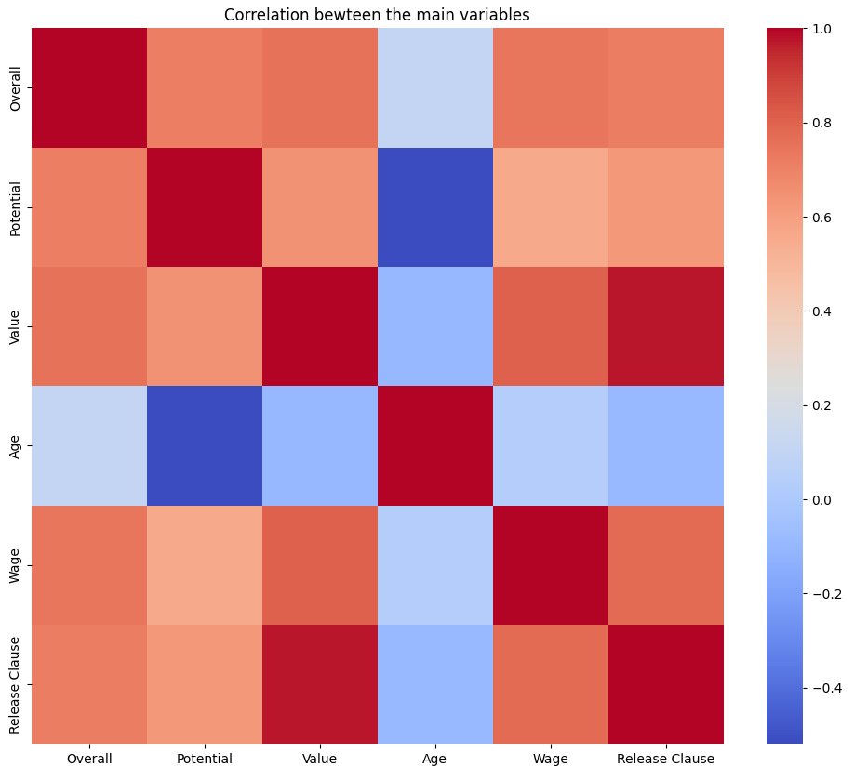
Checking correlation between
the main variables

Slide 3
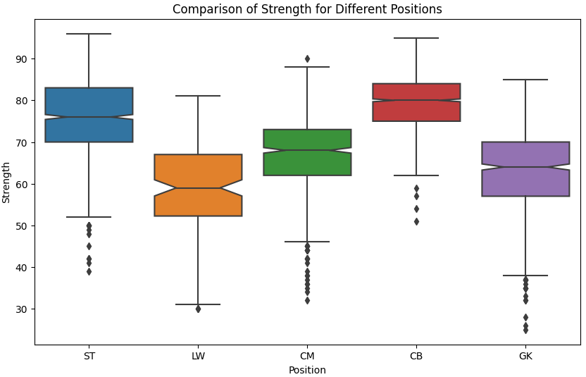
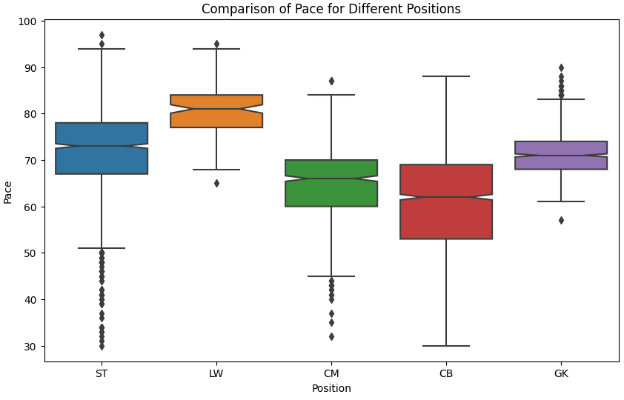
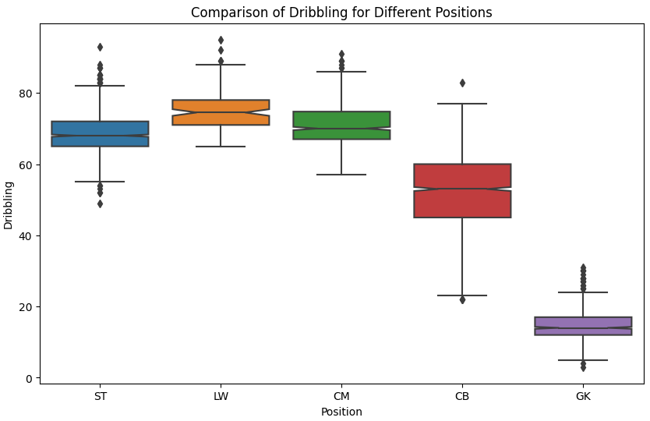
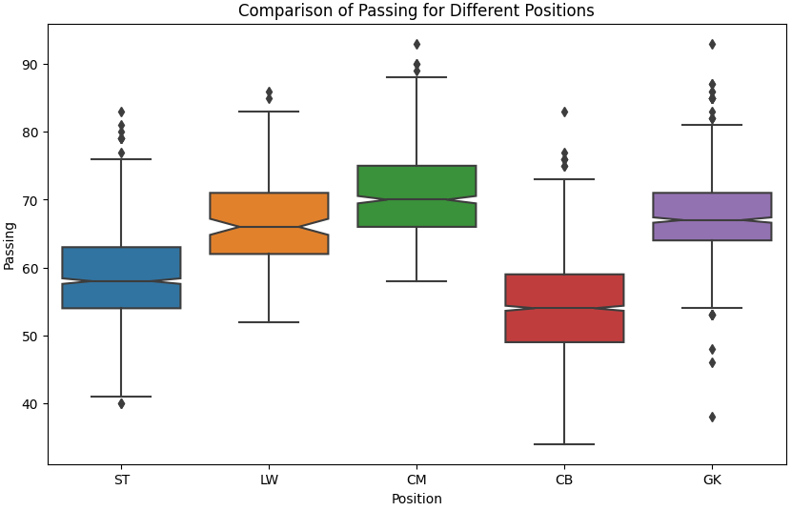
Comparison of some qualities
with different positions within the field

Slide 4
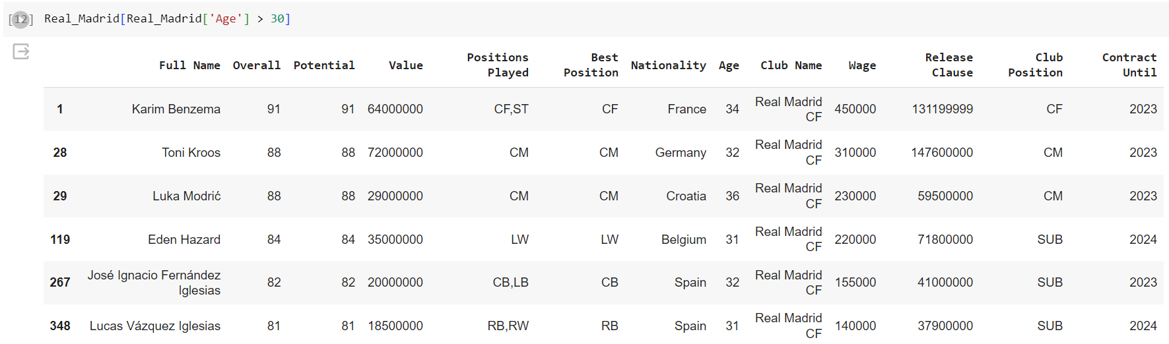
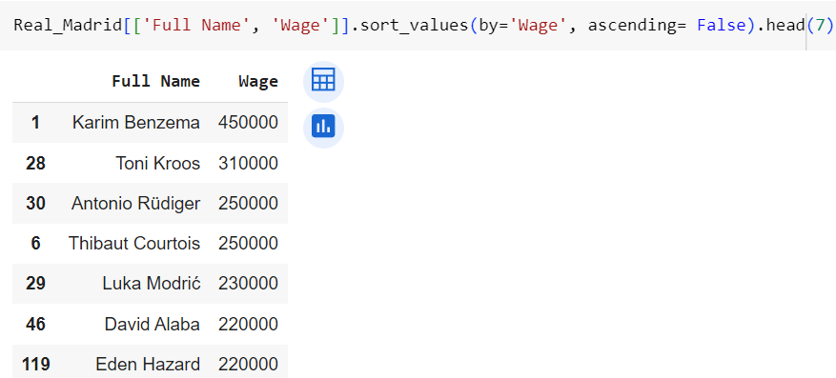
Checking for old players
Taking a look at the wages

Slide 5


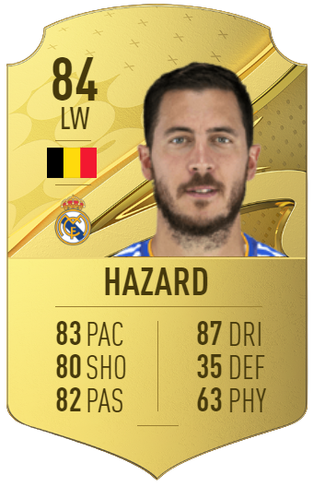
Players to sell
Karim Benzema
Luka Modric
Eden Hazard
130.000.000 €
71.000.000 €
60.000.000 €

Slide 6
Budget
Team Budget: 100 M
Money from transfers: 260M
Total: 360M

Slide 7
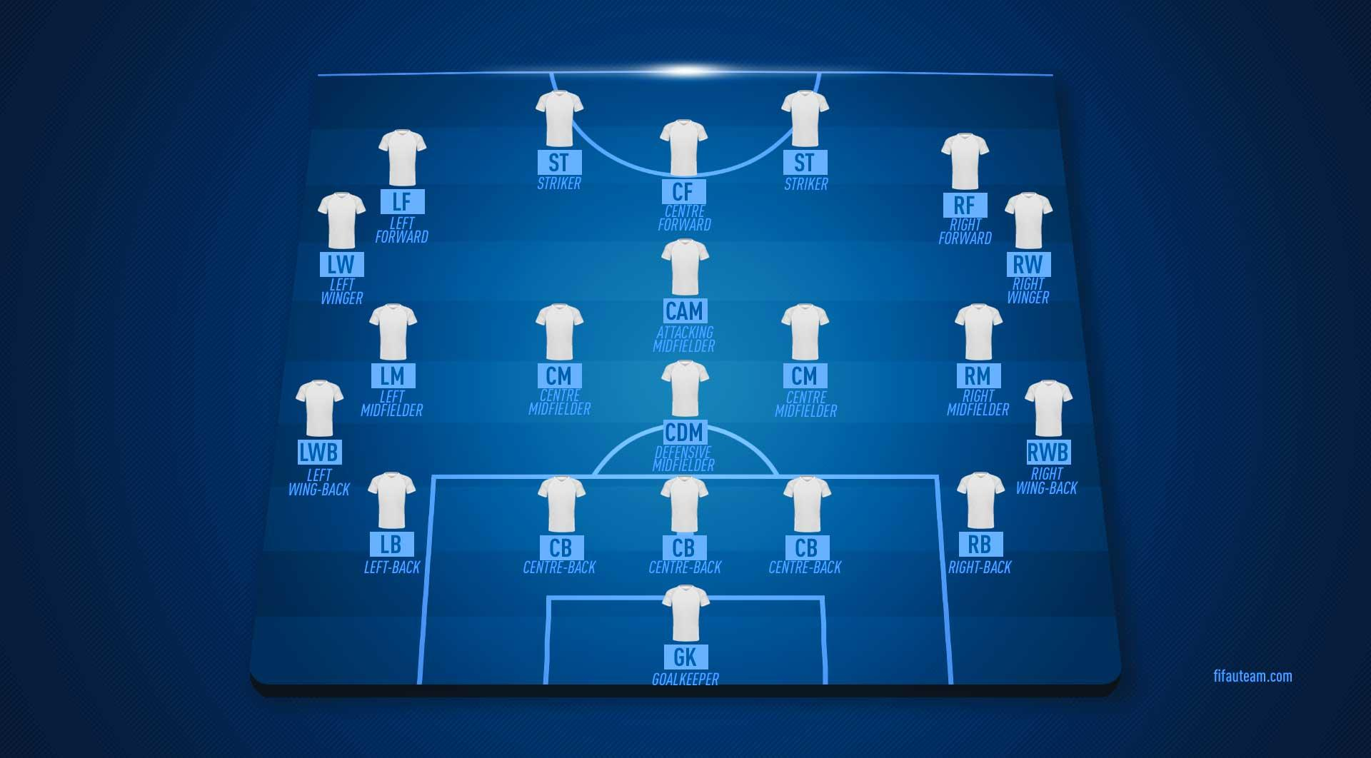

Slide 8
Overall performance > 70
Age < 25
Positions Played

Slide 9
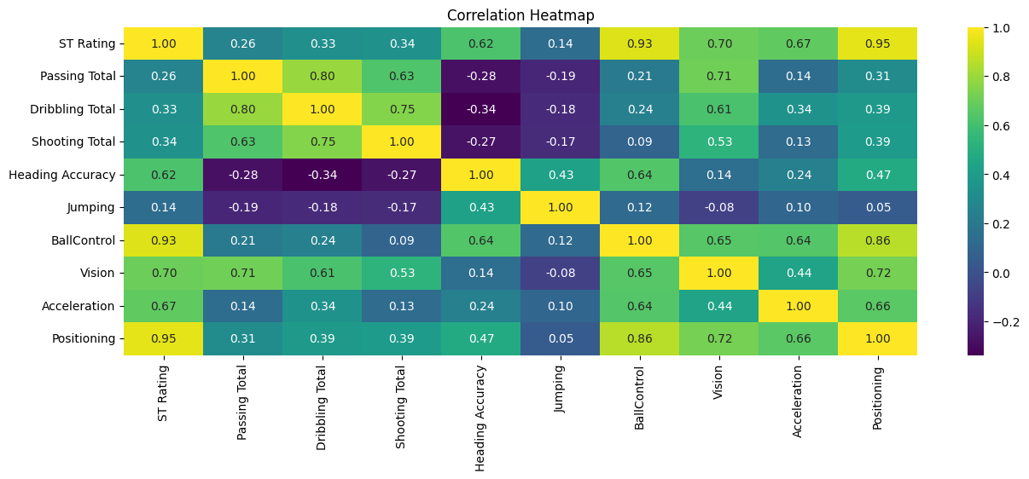
ST Rating
Passing Total
Dribbling Total
Shooting Total
Heading Accuary
Jumping
BallControl
Vision
Acceleration
Positioning
fifa_data_ST = fifa_data_23[(fifa_data_23['Age'] < 25) &
(fifa_data_23['Overall'] > 70) &
(fifa_data_23['Overall'] < 90) &
(fifa_data_23['Best Position'].isin (['ST','CF,ST','ST,LW','RW,ST']))]

Slide 10



Strikers to sign
1st Choice
2nd Choice
3rd Choice
Tammy Abraham
Victor Osimhen
Gianluca Scamacca
74.600.000 €
110.200.00 €
70.400.000 €

Slide 11
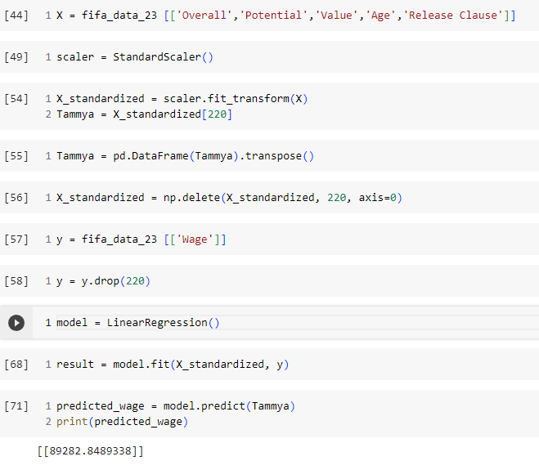
Wage prediction for our new Striker
Salary: 89280€

Slide 12
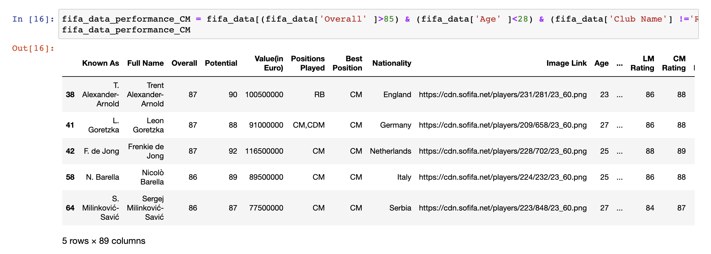
Overall performance > 85
Age <28

Slide 13
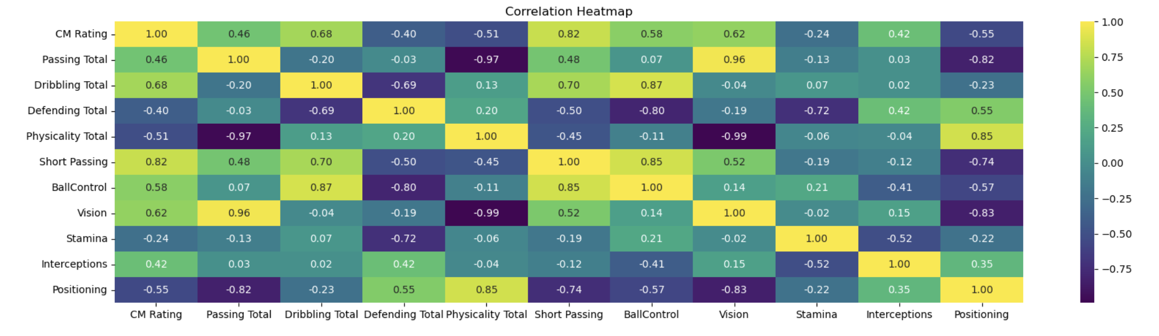
CM Rating
Passing Total
Dribbling Total
Defending Total
Physicality Total
Short Passing
Ball Control
Visión
Stamina
Interceptions
Positioning

Slide 14
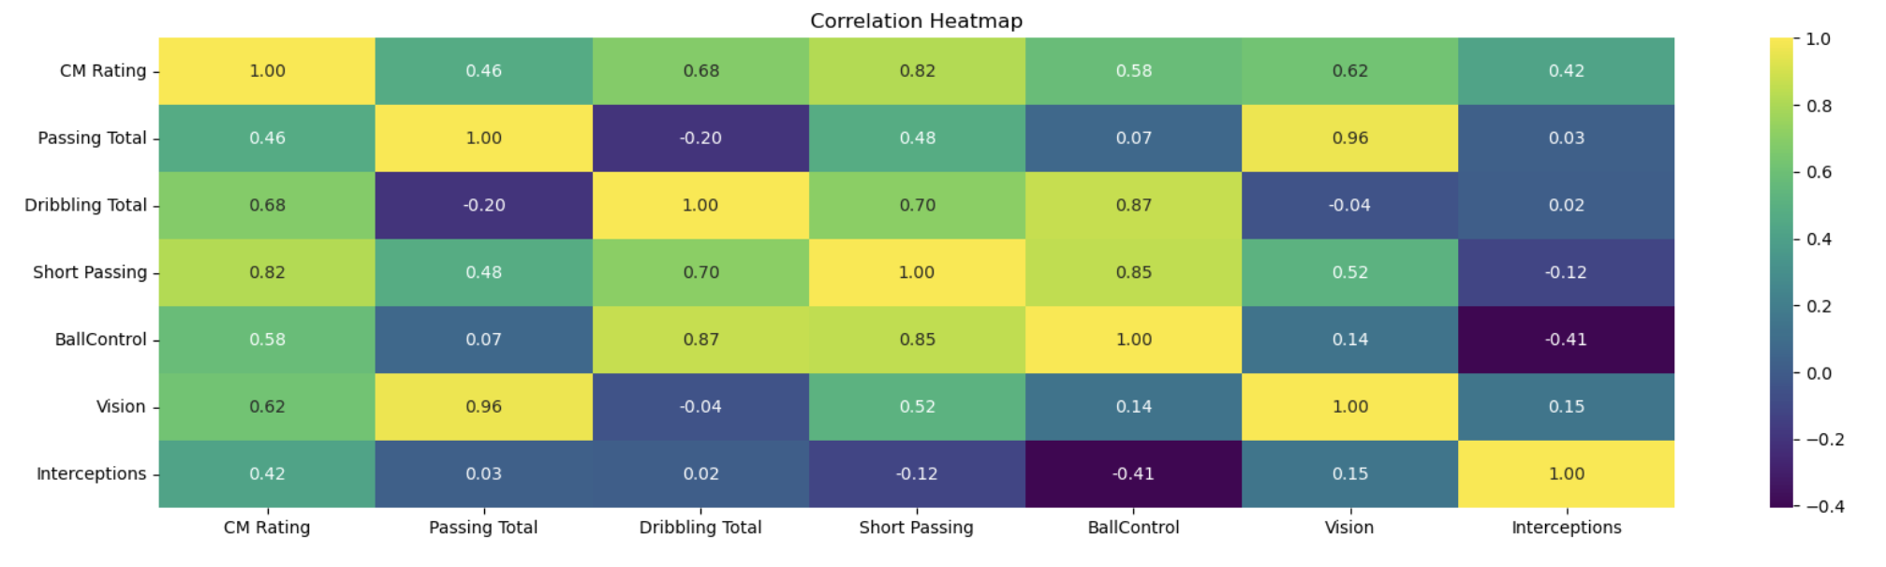
CM Rating
Passing Total
Short Passing
Visión
Dribbling Total
BallControl
Interceptions

Slide 15
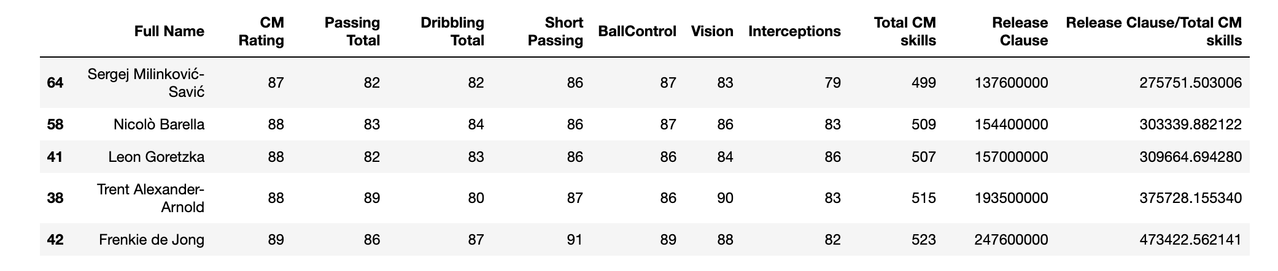
Release Clause/Total CM skills

Slide 16



1st Choice
2nd Choice
3rd Choice
Sergej Milinković-Savić
Nicolò Barella
Leon Goretzka
137.600.000 €
154.400.000 €
157.000.000 €

Slide 17
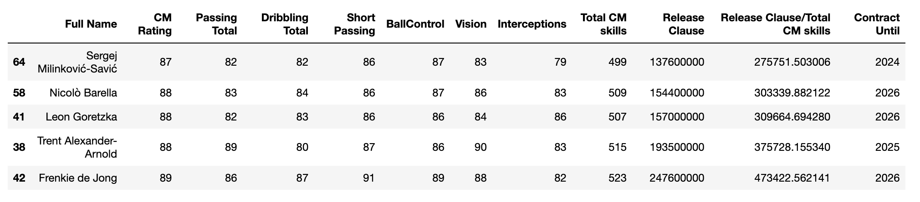
Sergej Milinković-Savić
Day of Contract End
90.000 €

Slide 18
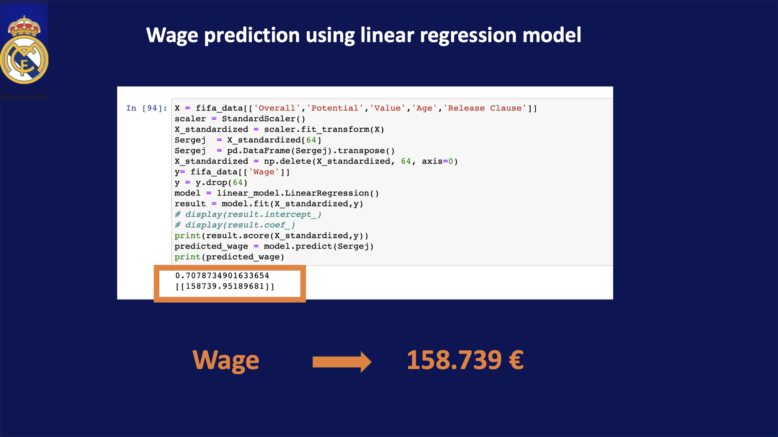
Wage prediction using linear regression model

Slide 19
Searching for LW players between 20 and 25 years old
and with a Potential higher than 85
Creating a new index that indicates how good the potential
of each player is compare to their Release Clause.

Slide 20



LW players to buy
Khvicha Kvaratskhelia
Rafael Leao
Marcus Rashford
35.000.000 €
126.000.000 €
73.000.000 €

Slide 21
Khvicha Kvaratskhelia
35.000.000 €

Slide 22
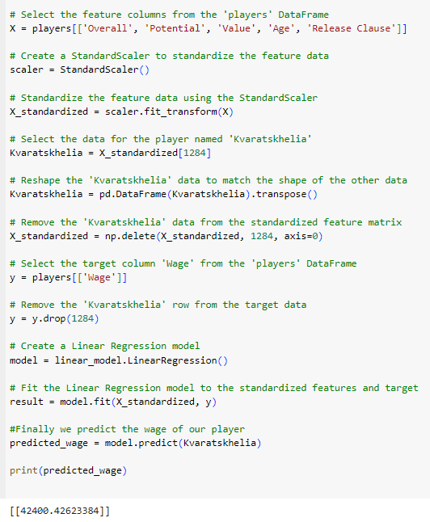
Wage prediction for our new signing
Salary
42400 €

Slide 23
Challenges
Trello Board
Time limitation
Too many variables

